Slide 1
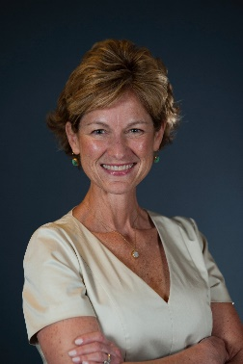
Pamela
Pam Buckley is a Certified Regulatory Compliance Manager (CRCM) with over 30 years of experience and expertise in the financial services industry. Leveraging 13 years of regulatory experience with the FDIC, Pam has dedicated the past 20 years to delivering best-in-class compliance consulting, risk assessment, monitoring, and training services to financial institutions of all sizes and charters. For many of Capco’s clients, Pam has helped develop and implement comprehensive Compliance Management Systems and facilitated successful regulatory Examinations. Pam’s examiner background gives her insight into regulatory expectations, and her consulting experience provides insight into practical solutions for Capco clients. Pam co-leads Capco’s Community Banking Consulting Practice and champions the firm’s Compliance Risk Management Solutions. While with the FDIC, Pam filled key roles including Review Examiner, Acting Consumer Affairs Specialist, and Senior Compliance Examiner in the Northeast. Pam, a published author and frequent speaker at trade association meetings and conferences, is recognized as a trusted advisor and client champion.
Buckley
Managing Principal
Community Banking Domain
30+ years in relevant experience within Risk and Compliance
CLIENT & PROJECT | ROLE | ACHIEVEMENTS
Regional Bank with $5+B in Assets: | Project Manager | Pam supported a regional bank with 30+ branches located throughout MA for 15 years. Working closely with the Compliance Officer and all Compliance Committee members, Pam and team added value by helping to administer an effective Compliance Management System, providing for ongoing compliance consulting, risk assessments, and monitoring. Pam also educated the bank’s Board of Directors and Executive Officers annually. Having contributed toward the client’s successful Compliance and CRA Examinations for over a decade, this valued client considered Pam a trusted advisor to whom they turn for many risk management, information security and compliance needs.
Community Banks of all sizes: | Project Manager | Pam routinely supports community bank clients of all sizes and charter to prepare for successful Compliance and CRA Examinations and audits. She has served as Acting Chief Compliance Officer for numerous community banks, helping to administer, enhance and optimize each organization’s CMS and avoid and remediate costly compliance violations and enforcement actions.
Non-depository Financial Institutions: | Project Manager | Pam has led multiple engagements for non-depository financial institutions where she helped to stand up a robust CMS, establish and direct an effective Compliance Committee, and provide ongoing regulatory updates to key personnel. Her efforts resulted in successful CFPB Examinations for several non-banks and fintechs.
Board/Executive Management Education
Compliance Management Systems
Consumer Complaint Management
Fair and Responsible Banking (i.e., CRA, ECOA, FCRA, FHA, HMDA, UDAAP)
Financial Crime Prevention
Regulatory Change Management
Regulatory Examination Preparedness and Remediation
Third Party Risk Management
B.S in Finance/Investments Babson College 1989
English

